Slide 1


Setting Multiple SSH Keys for Several GitHub Accounts

Slide 2

Agenda
Setting up several SSH keys for multiple Git Accounts
Setting up the proper config files to load different settings according to where you clone the repo.

Slide 3
SSH Keys and several Accounts
As explained before, SSH keys are a useful way to authenticate an user without having to use a password and go to through the login process.
Setted up properly, that means that you can have several GitHub (or any other Git Hosting platform) accounts set, without conflicting one with the other, having to sign in/out, or making commits with other account by mistake.

Slide 4
SSH Keys - Steps for 2 accounts
We will run the SSH-Agent to create 2 different SSH keys pair. We will give them different names.
We would put each Public SSH key on the right account.
We would add the private keys to the local ssh-agent.
Then, we will create some configuration files. We need to set 2 things:
When cloned, which SSH key to use
When commiting, which account to use as default.

Slide 5
SSH Keys
Let’s follow the steps that we did on the previous SSH Keys slides.

Slide 6
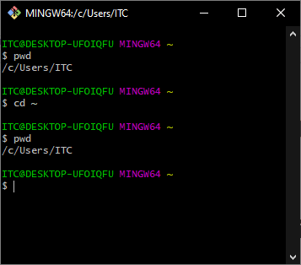
SSH Keys - Setting the first SSH Key
Open a terminal window.
Let’s check which one is our default Home directory. We can see that by doing:
cd ~ && pwd
In Mac/Linux should look like:
/Users/<my_user>

Slide 7
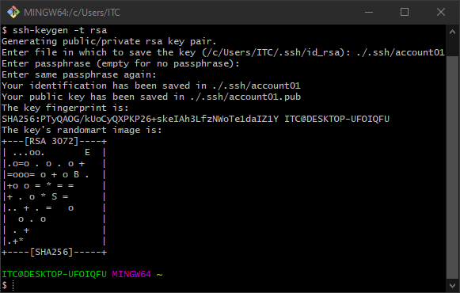
SSH Keys - Setting the first SSH Key
Create a new pair:
ssh-keygen -t rsa
Let’s change the default name:
~/.ssh/account01
Set a passphrase

Slide 8
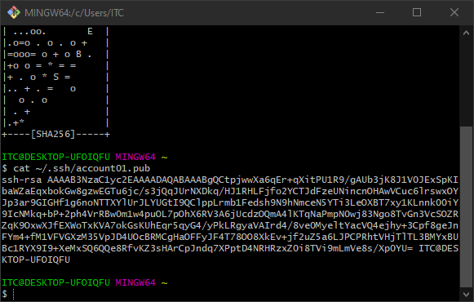
SSH Keys - Setting the first SSH Key
Let’s copy that content and paste it on account01 github:
cat ~/.ssh/account01.pub
Copy the string

Slide 9
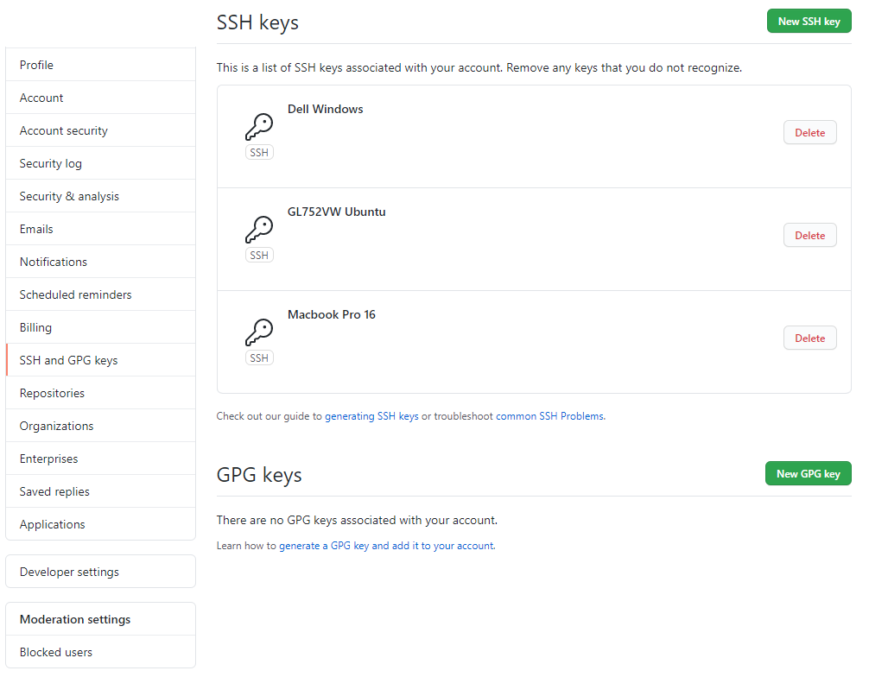
SSH Keys - Setting the first SSH Key
Click on New SSH Key

Slide 10
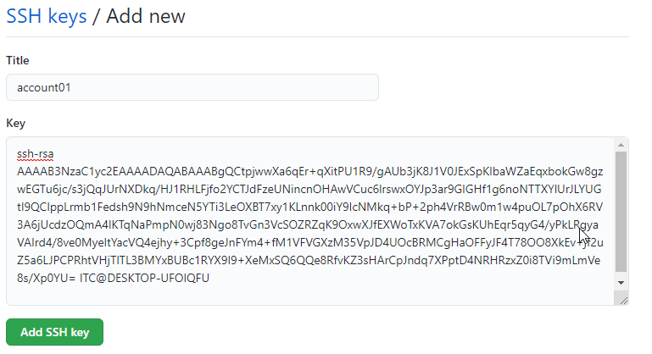
SSH Keys - Setting the first SSH Key
Paste the SSH Public Key, and add the SSH key.
Then go back to your terminal

Slide 11
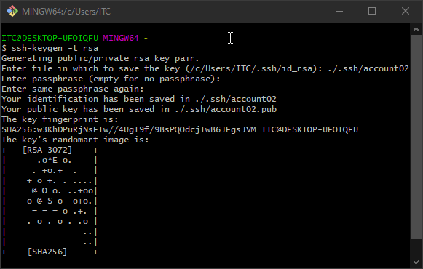
SSH Keys - Setting the second SSH Key
Repeat for the second account:
ssh-keygen -t rsa
Enter file name:
./.ssh/account02
Set a passphrase

Slide 12
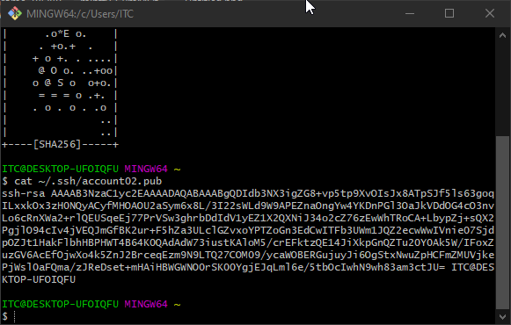
SSH Keys - Setting the second SSH Key
Let’s copy that content and paste it on account02:
cat /.ssh/account02.pub
Copy the string

Slide 13
SSH Keys - Setting the second SSH Key
Go to the second account. Click on New SSH Key

Slide 14
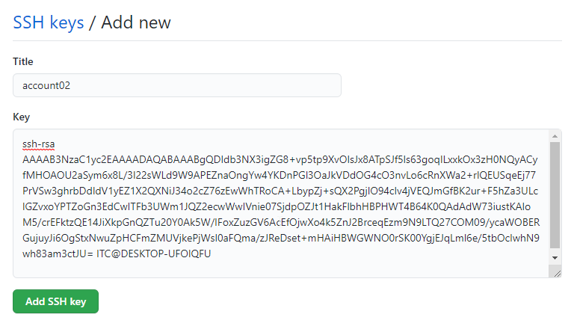
SSH Keys - Setting an SSH Key for GitHub
Go to the second account. Paste the SSH Public Key, and add the SSH key.
Then go back to your terminal

Slide 15
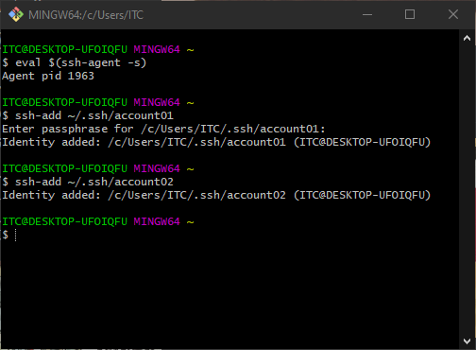
SSH Keys - Setting an SSH Key for GitHub
Add the SSH key to the agent
eval $(ssh-agent -s)
Add both SSH keys to the agent:
ssh-add ~/.ssh/account01
ssh-add ~/.ssh/account02

Slide 16
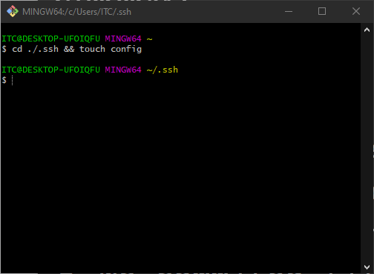
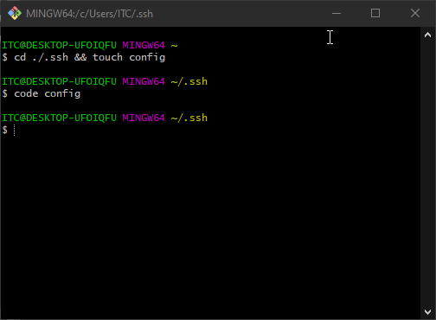
SSH Keys - Creating the config files
Lets get inside the .ssh folder and create a config file.
cd ./.ssh && touch config
Lets open that file. We can use VSC for that, nano, etc.
code config
NOTE: Mac users might need to add first the code command!

Slide 17
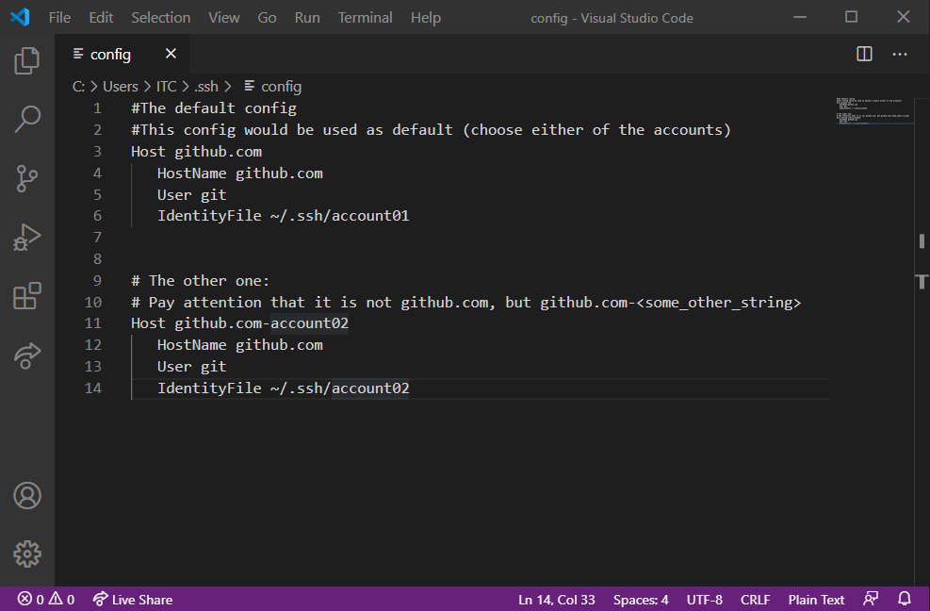
SSH Keys - Creating the config files
Save the changes.
Pay attention to the Hosts names given:
You need to set a different one for the second account.

Slide 18
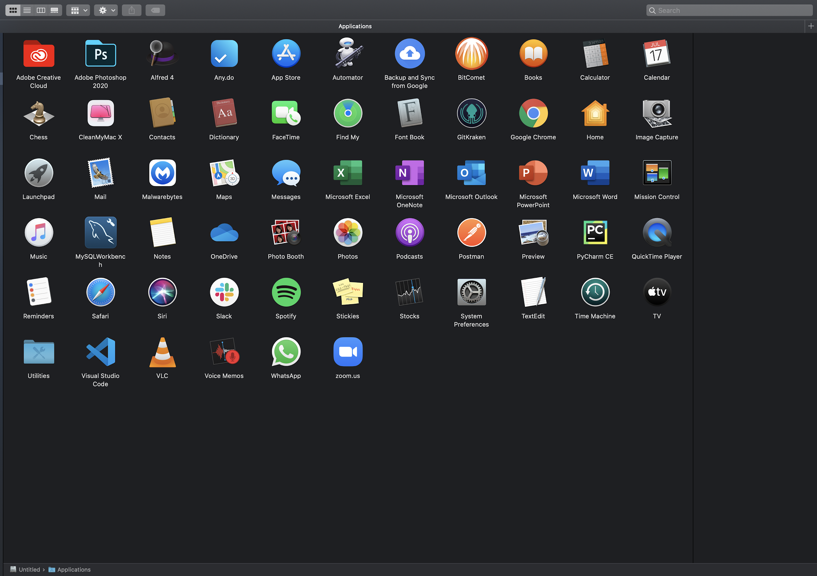
SSH Keys - MAC: adding ‘code’ to open VSC
Check that VSC is installed in Applications. If not, please install in this location.

Slide 19
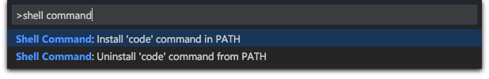
SSH Keys - MAC: adding ‘code’ to open VSC
Open Visual studio code
Open the Command Palette (⇧⌘P) and type 'shell command' to find the Shell Command: Install 'code' command in PATH command.
Restart the terminal
It is important that you do this step, you will need it further on.

Slide 20
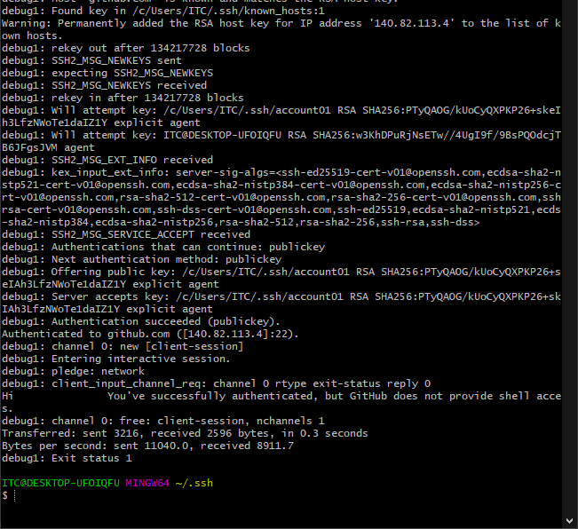
SSH Keys - Checking the SSH Keys
Back to the terminal, let's check that both host names work:
ssh -vT git@github.com

Slide 21
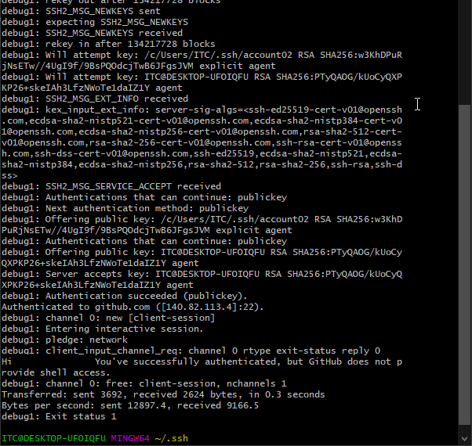
SSH Keys - Checking the SSH Keys
Back to the terminal, let's check that both host names work:
ssh -vT git@github.com-account02

Slide 22
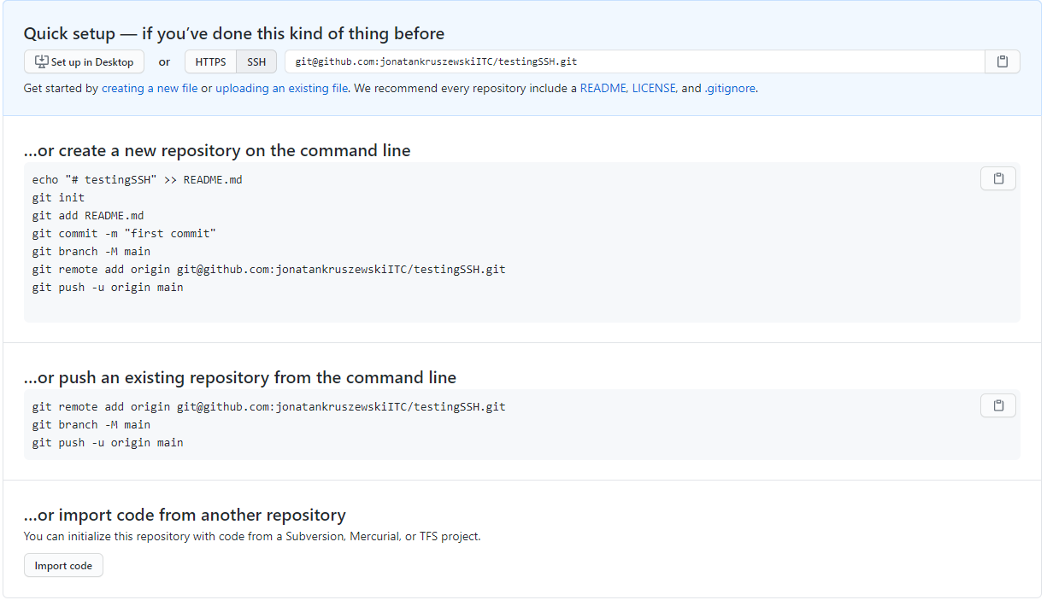
SSH Keys - Cloning Repos
So far, we have linked two SSH keys to 2 different GitHub Accounts.
When creating / cloning a new repo use the SSH link

Slide 23
SSH Keys - Cloning Repos
For cloning repos we would use the SSH method provided in the link
Attention!
For the repos being cloned from the account that uses as host github.com we would use the links as is.
For the repos being cloned from the other account we would need to modify the link each time to: @github.com-account02

Slide 24
SSH Keys - Cloning Repos
Cloning on the default settings:
git clone <git@github.com:my_user/some_repo.git>
Cloning with the second account:
git clone <git@github.com-account02:my_user/some_repo.git>
You would need to manually add the Host name set up in the config file earlier.

Slide 25
SSH Keys - Setting the account for commit
Lastly, the last thing that you need to do, is to set up which user us as default to commit.
You can do it by setting conditionals on the paths:
If the repo is cloned on a specific folder in your PC, to use account A.
Else, the repo is cloned on other specific folder in your PC, use account B.
The file setting is different from Windows to Mac/Linux. So pay attention to which slide you should look to.

Slide 26
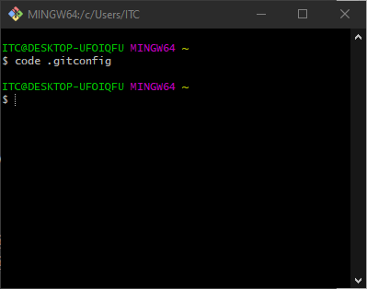
SSH Keys - Modifying .gitconfig
Lets modify the .gitconfig file.
If you don’t have it, create it.

Slide 27
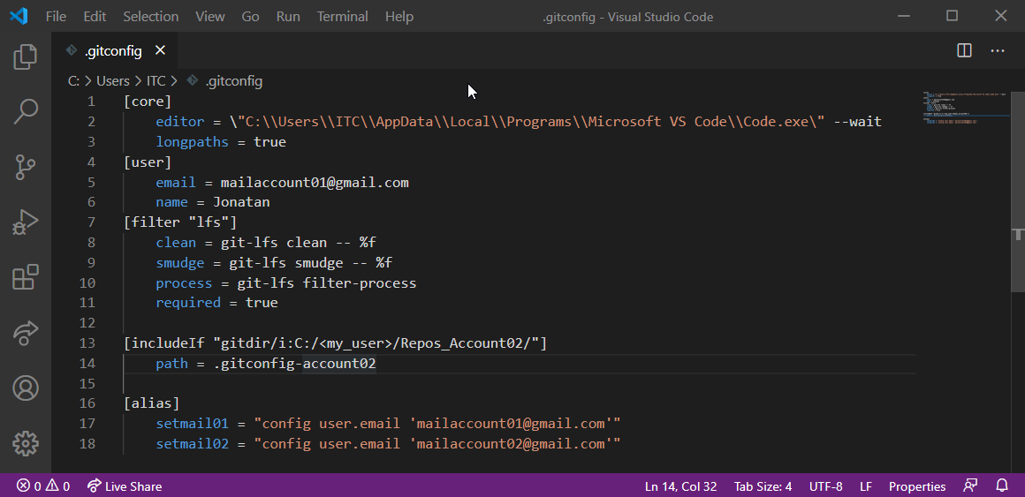
SSH Keys - Windows: Modifying .gitconfig
Pay attention to the include if. That means that if the directory is cloned in that path, use other config file
Path to:
C:/<my_user>/Repos_account02
(or any other folder in your system)

Slide 28
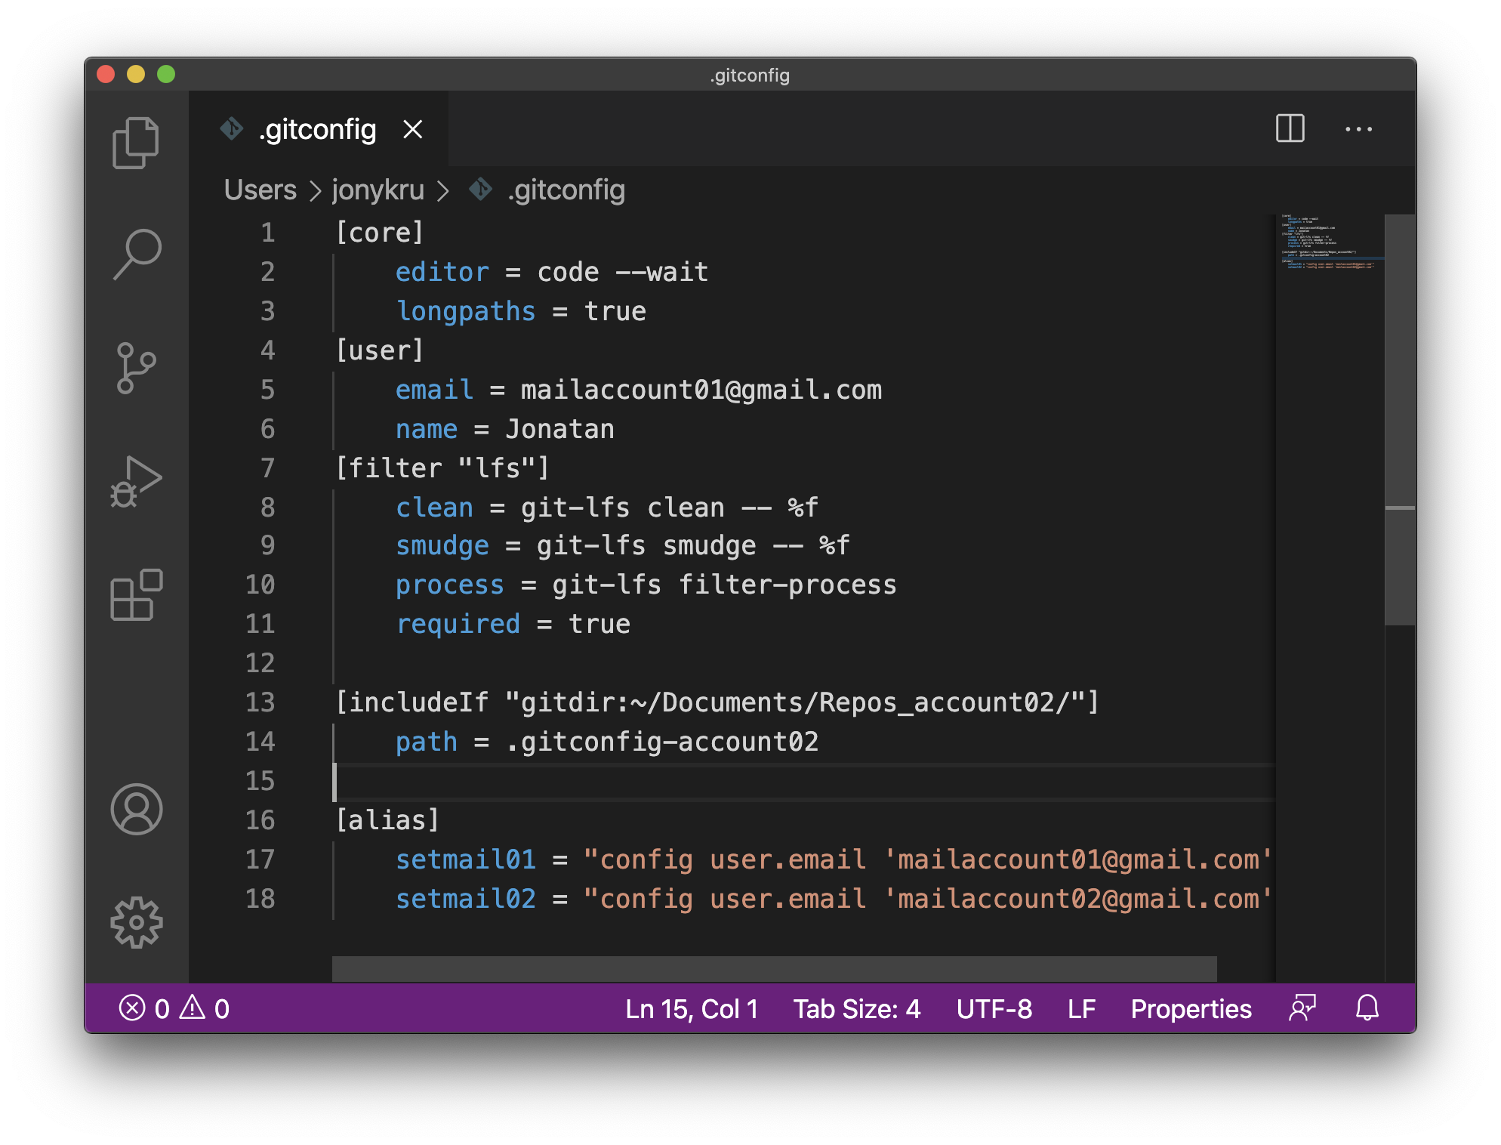
SSH Keys - MAC: Modifying .gitconfig
Pay attention to the include if. That means that if the directory is cloned in that path, use other config file

Slide 29
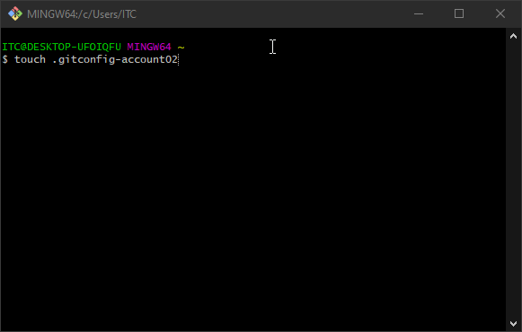
SSH Keys - Creating the second config file
Copy the whole content and Save the file
We will do the same for a second .gitconfig file with slight differences. We can create it through the terminal, or copy paste the file and renaming it.

Slide 30
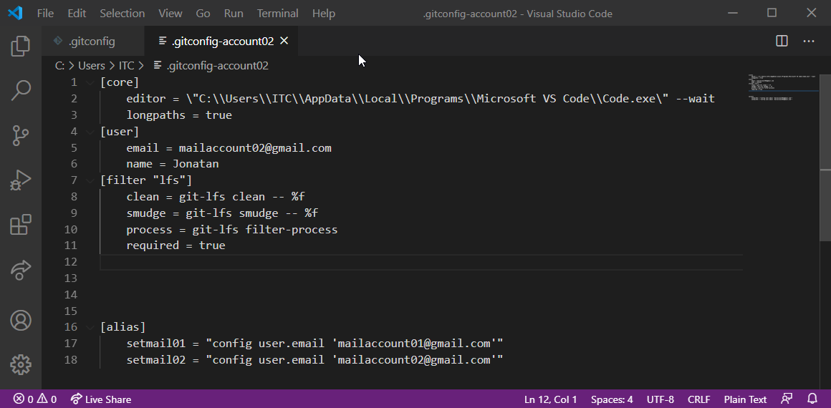
SSH Keys - Windows: .gitconfig-account02
No include if in this file!
That means that if we are working at ANY OTHER folder that is not the one specified in the first file, we will have this account as default.

Slide 31
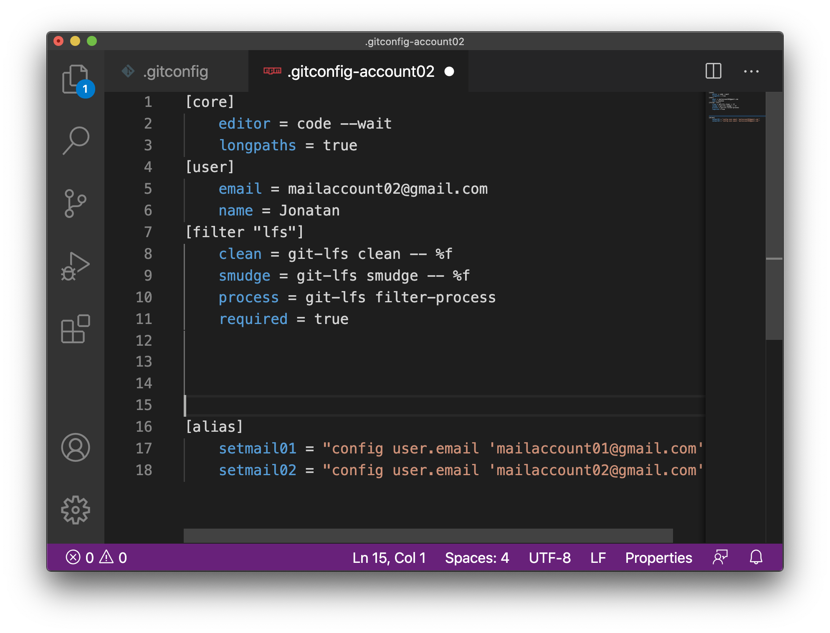
SSH Keys - MAC: .gitconfig-account02
No include if in this file!
That means that if we are working at ANY OTHER folder that is not the one specified in the first file, we will have this account as default.

Slide 32
SSH Keys - Aliases
Additionally we can type:
git setmail01
Or:
git setmail02
To switch between accounts :)

Slide 33
SSH Keys - Wrapping up
We created 2 SSH keys and paired them with each GitHub Account
We created a .config file inside the .ssh folder to set up two ways to clone repos:
git clone <git@github.com:my_user/some_repo.git>
git clone <git@github.com-account02:my_user/some_repo.git>
We created also 2 .gitconfig files, one of them with a conditional path. If it is a specific folder (where we are going to store all the repos from the second account) use account02, if not, use the ones of the .gitconfig file.

Slide 34
Resources
T
https://www.freecodecamp.org/news/manage-multiple-github-accounts-the-ssh-way-2dadc30ccaca/
https://medium.com/@pinglinh/how-to-have-2-github-accounts-on-one-machine-windows-69b5b4c5b14e
https://www.cloudsavvyit.com/2245/how-to-manage-multiple-git-accounts-on-one-system/
https://stackoverflow.com/questions/3860112/multiple-github-accounts-on-the-same-computer

